Slide 1
Choosing the Best Partition for the Output from a Large-Scale Simulation
Emily Casleton*, Chelsea Challacombe†, Jonathan Woodring‡
August 1, 2019
*Statistical Sciences, LANL
†University of California-San Diego
‡Computational Physics and Methods, LANL
LA-UR-19-27351

Slide 2

Motivation: Computers and Simulations are faster
Computing power has increased at a faster rate than:
bandwidth for storing data
bandwidth for accessing memory
Can perform large-scale, high-resolution simulations, but
cannot look at all the data at once
impossible to store everything
Exascale
Billion billion (10¹⁸) calculations per second (exaFLOP)
Billion billion (10¹⁸) bytes of storage per simulation time step
Increase by a factor of 100 by today’s standards
I/O and bandwidth expected to increase by factor of 10
Photo: https://itpeernetwork.intel.com/making-exascale-computing-reality/#gs.rllfj9

Slide 3
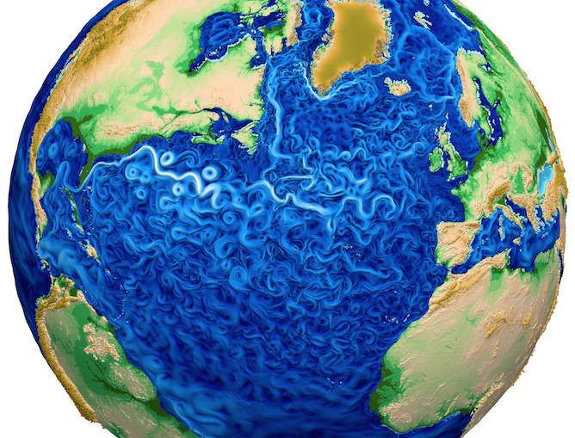
Possible Solution: In-situ analysis
In Situ analysis – move some analysis or diagnostics into the simulation rather than transferring all results to storage
Data reduction at run time
Potential to save disk space and analysis time
If a mistake is made – then simulation needs to be re-run
Increases computational burden of simulation
Lightweight solutions
Quantify what was discarded
Photo courtesy of: Ringler, T., Petersen, M., Higdon, R. L., Jacobsen, D., Jones, P. W., & Maltrud, M. (2013). Ocean Modelling. Ocean Modelling, 69(C), 211–232. doi:10.1016/j.ocemod.2013.04.010

Slide 4
In-Situ Analysis Example: Spatial Partitioning
Goal: Save less data within a single time step
Partition the spatial scene and only save summary information
KD-tree algorithm to choosing partitions
Axis aligned
Binary
Photo courtesy of: Nouanesengsy, Boonthanome, et al. "ADR visualization: A generalized framework for ranking large-scale scientific data using analysis-driven refinement." Large Data Analysis and Visualization (LDAV), 2014 IEEE 4th Symposium on. IEEE, 2014.
Notes:
Top down vs. Bottom up
Boxes—why?

Slide 5
KD-tree algorithm as a gif

Slide 6
Spatial Partitioning Options
What are the partitioning variables?
What Block to split next:
Maximum range
Maximum variance
Largest difference between mean and median
Round robin
Where to split block:
At middle of block length
At median of data
At mean of data
When to stop splitting:
When all blocks below an “acceptable” statistic (range, variance, etc.)
When allowable storage resource reached
When fixed number of blocks created
Until maximum acceptable “error” is reached
How to assign a value to a block:
Mean data value
Median data value
Midpoint data value
Max. and Min. of values
How to define error:
Mean error
Median error
Maximum error
Percentile of error

Slide 7
Spatial Partitioning Options

Slide 8
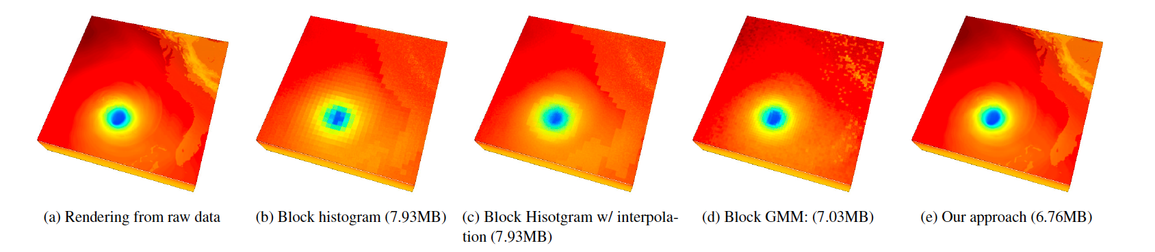
How to choose which is best?
There are a lot of decision that need to be made in choosing a partitioning scheme.
Visualization? Analysis?
Post-processing
Maybe not robust
Metric that incorporates competing criteria
Storage size versus precision
Photo courtesy of: Wang, Ko-Chih, Kewei Lu, Tzu-Hsuan Wei, Naeem Shareef, and Han-Wei Shen. "Statistical visualization and analysis of large data using a value-based spatial distribution." In 2017 IEEE PacificVis) pp. 161-170. IEEE, 2017..

Slide 9
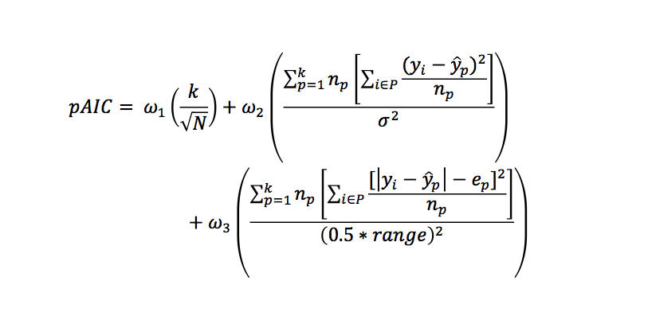
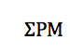
Spatial Partitioning Metric (𝚺PM)
In words: number of partitions + SSE + error of error

Slide 10
How the metric is implemented
Scientists runs a few runs of simulation.
Try out a few partitioning schemes
Choose the most appropriate for the dataset
In-Situ Assessment:
Used in a similar manner to control charts
Can flag when the partitioning storage is “not in control”, outside acceptable bounds

Slide 11
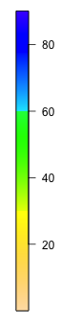
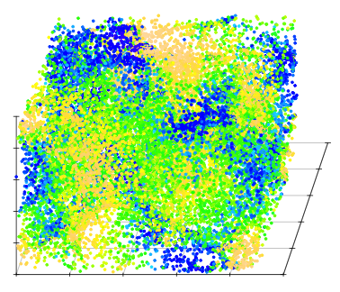
Application #1: Cosmology
Large-N body simulation of dark matter physics from the Road Runner Universe MC³
Variable of interest: x direction velocity
One time step:
64 billion particles
2.3 TB

Slide 12
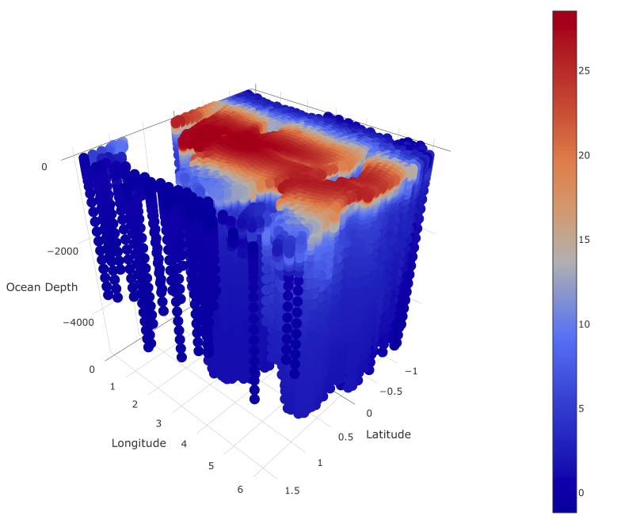
Application #2: Ocean
Models for Prediction Across Scales-Ocean (MPAS-O)
Environmental simulation codes for the purpose of studying anthropogenic climate change
Can resolve various resolutions in a single simulation
Variable of interest: temperature
One time step:
3.7 million horizonal cells
100 layers
90 GB

Slide 13
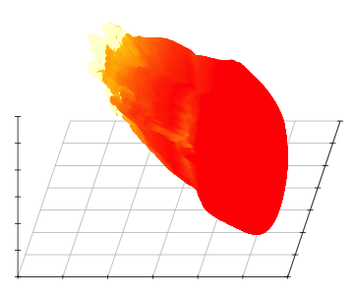
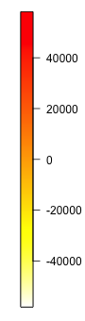
Application #3: Asteroid
Entry of the asteroid into atmosphere can be simulated using xRAGE, a multi-physics, parallel Eulerian hydrodynamics code
ASC program at LANL
One time step
160,862,898 rows
20 GB
Variable of interest: temperature

Slide 14
Applications Summary
 | Variable of Interest | Size of raw data (number of rows)
Cosmology | Velocity in the x-direction | 32,768
Ocean | Temperature of the water | 57,536
Asteroid | Temperature of asteroid in electron volts | 13,253,253

Slide 15
Comparison Study
 | Mean Partitioning Scheme | Median Partitioning Scheme | Midpoint Partitioning Scheme
Splitting variables Cosmology/Asteroid Ocean | x,y,z lat, long, ocean depth | x,y,z lat, long, ocean depth | x,y,z lat, long, ocean depth
2. Cycle | Round robin | Round robin | Round robin
3. Partition Location | Mean | Median | Midpoint
4. Stopping Criteria Cosmology Ocean Asteroid | Cell count Cell count Maximum Range | Cell count Cell count Maximum Range | Cell count Cell count Maximum Range
5. Partition Representation | Mean | Median | Midpoint
6. Error Representation | Mean | Mean | Mean
7. ω₁, ω₂, ω₃ Cosmology Ocean/Asteroid | 0.25, 0.25, 0.5 0.1, 0.1, 0.8 | 0.25, 0.25, 0.5 0.1, 0.1, 0.8 | 0.25, 0.25, 0.5 0.1, 0.1, 0.8

Slide 16
Results-Different partitioning schemes and stopping criteria
Cosmology
Ocean
Asteroid

Slide 17
Percentage each term contributes to the metric
Minimum 𝚺PM
term1 = 0.46
term2 = 0.32
term3 = 0.20
Notes:
To further explore this concept, consider
Figure 16. This plots the percentage of the pAIC metric each of the three terms contributed
to the pAIC metric against the number of partitions for the mean partitioning scheme(first
column in Table 3 with results displayed in Figure 15 (a)). As the number of partitions increases, the first term, which represents the number of partitions, begins to dominate the
metric. Ocean data.

Slide 18
Exploration of weights: Sensitivity of Solution
105 partitioning schemes
Pareto front identified 29
Scenario 86 represents 15% of the triangle.
Midpoint-cell count partitioning schemes represent 51% of the triangle
Midpoint-cell count perform well when terms 1 and 3 are weighted more heavily, but others are more appropriate if term 2 has larger weights
Notes:
which partitioning scenarios minimize the pAIC for different combinations of weights, {ω1, ω2, ω3}.
Asteroid data

Slide 19
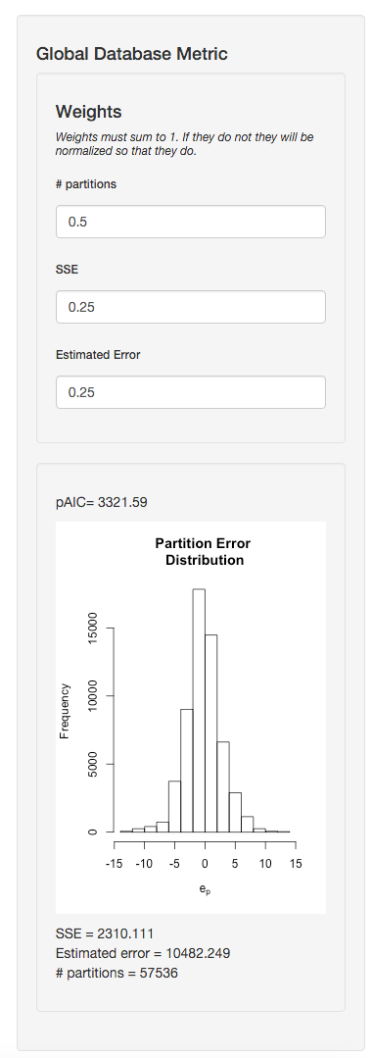
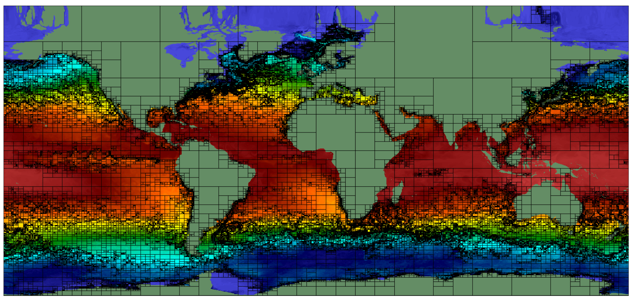
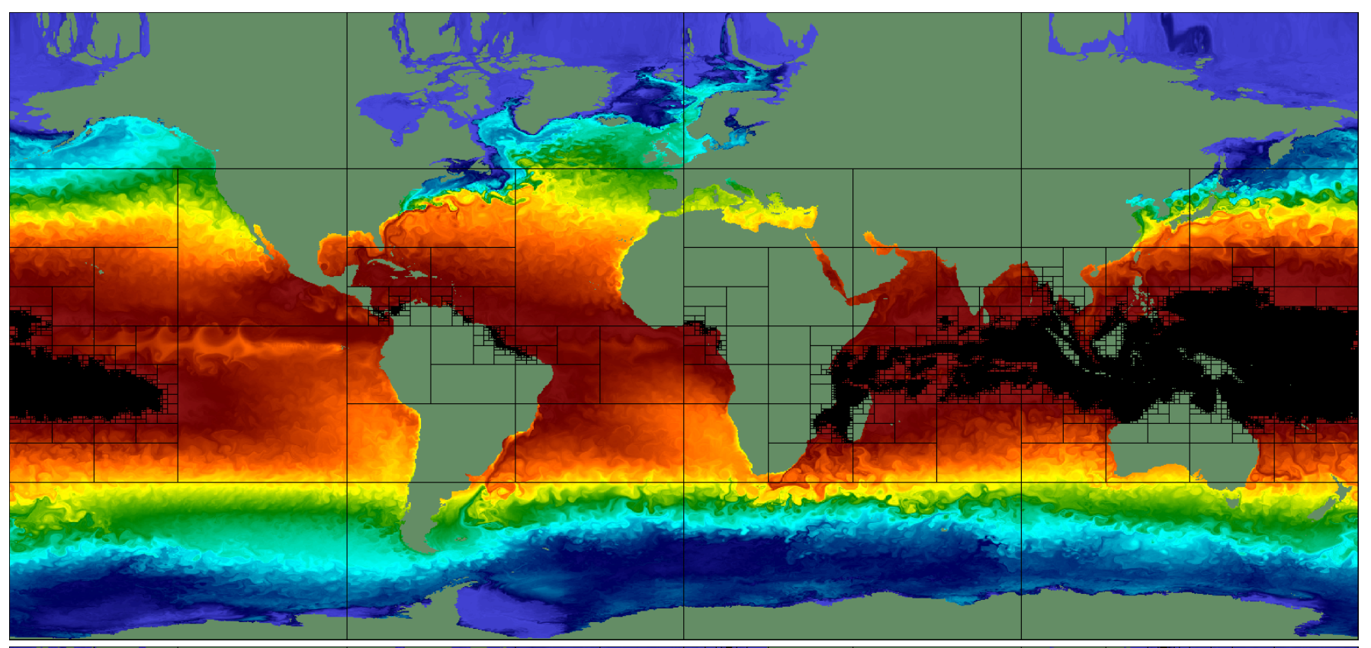
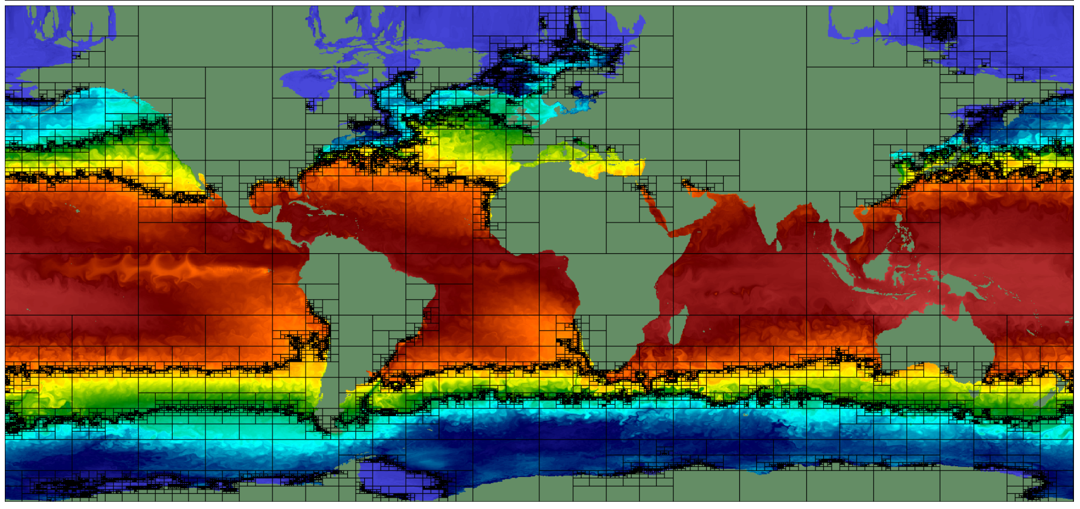
Conclusions
Introduced a metric to determine the most appropriate spatial partitioning scheme to subset the output from a large-scale simulation
Spatial and time partitioning already exists. Most common is uniform.
Allows researchers to make more informed choices.
3
2
1

Slide 20
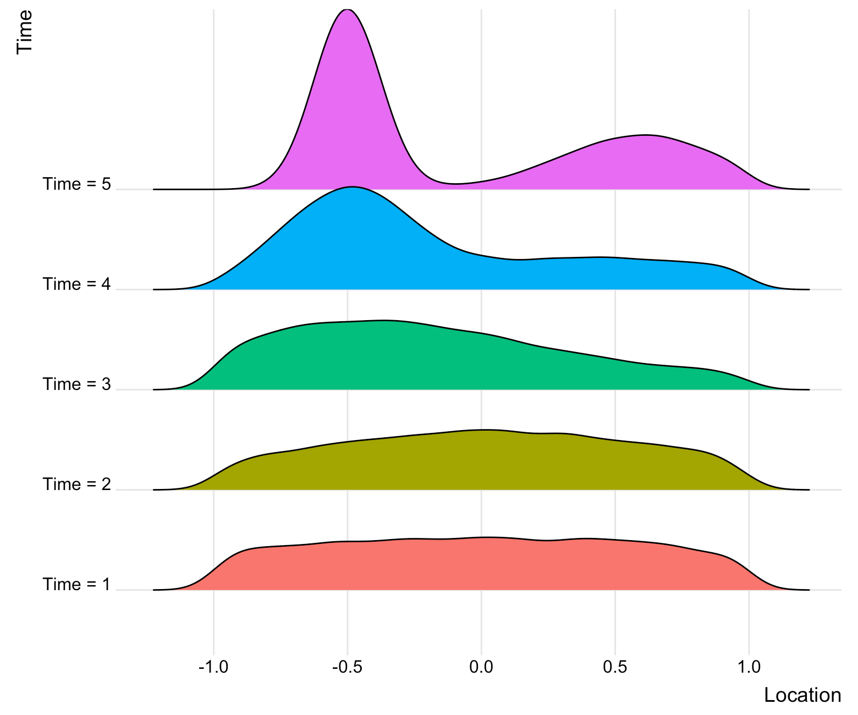


Future Work
Save a distribution from each partition, not just summary statistics.
E.g., Gaussian Mixture Models.
Let the metric guide the partitioning.
Metric also determines time step selection.
Factorial comparison study.

Slide 21
Pareto Front References
Anderson-Cook, C., & Lu, L. (2012). Weighing Your Options. Quality Progress, 45 (10), 50-52.
Chapman, J. L., Lu, L., & Anderson-Cook, C. M. (2014). Incorporating response variability and estimation uncertainty into Pareto front optimization. Computers & Industrial Engineering,76, 253-267.
Lu, L., & Anderson-Cook, C. M. (2012). Rethinking the Optimal Response Surface Design for a First-Order Model with Two-Factor Interactions, When Protecting against Curvature. Quality Engineering, 24 (3), 404-422.
Lu, L., Anderson-Cook, C. M., & Robinson, T. J. (2011). Optimization of Designed Experiments Based on Multiple Criteria Utilizing a Pareto Frontier. Technometrics, 53 (4), 353-365.

Slide 22
Work with
Internationally
Los Alamos
National Laboratory
Is Looking for
Excellent Statisticians
Recognized
Statisticians
and Scientists
ASA Fellows
Journal Editorial Board Members
Conference Founders
A Network of International Collaborators
30 Colleagues, Early Career to Senior Professionals
Contribute to cutting-edge scientific applications of national importance in a multidisciplinary, collaborative environment.
Over 40 Articles with 100+ Citations
Develop innovative methods to address the challenges of real-world data.
For More Information Visit stat.lanl.gov
See your work having an impact!

Slide 23
Back up

Slide 24
Metric Limitations
Cost of a partition is linear
Does not account for error at non-measured locations
All partitions contribute to the metric the same, regardless of size
Assumes appropriate partitioning scheme remains same for all time steps of simulation
Control chart idea does not allow for modifying partitions.

